Slide 1
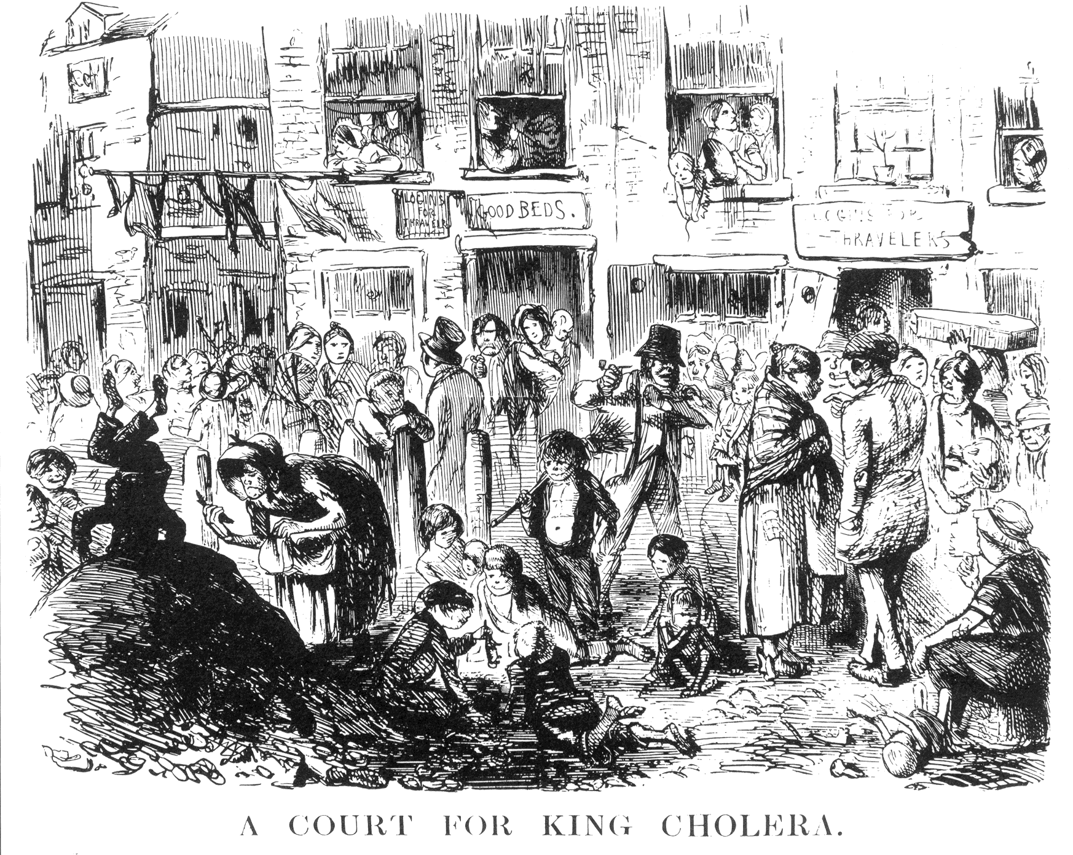

Slide 2
Good proposed explanations (hypotheses) are…
Mechanistic: Connects A and B
Characteristics are not mechanisms!
Measurable: We can test with experiments
Distinguishable: Leads to different predictions

Slide 3
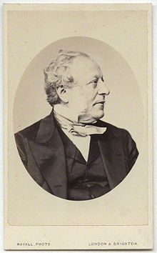
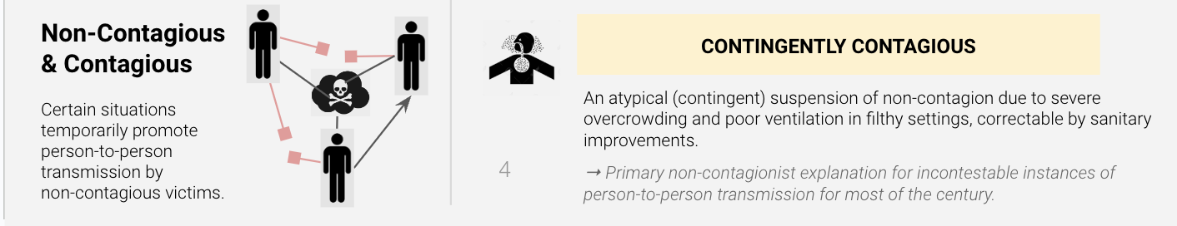
Explanations for cholera (19th Century London)
Francis Moon, Lord Mayor of London
Airborne-Poverty: People get cholera after inhaling polluted air but also infect each other in severely overcrowded quarters with unsanitary conditions (improved sanitary conditions would reduce disease risk). (...)

Slide 4
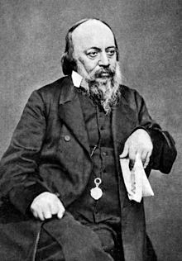
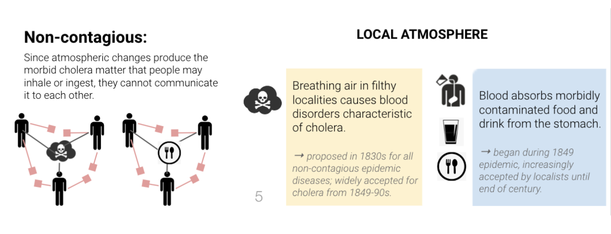
Explanations for cholera (19th Century London)
Edwin Chadwick, Sanitation Commissioner, General Board of Health
Locally Airborne - Non-contagious: People get sick by inhaling locally polluted air (e.g. coming from the pest field: move away from pest field) or ingesting something that was air-polluted. (...)

Slide 5
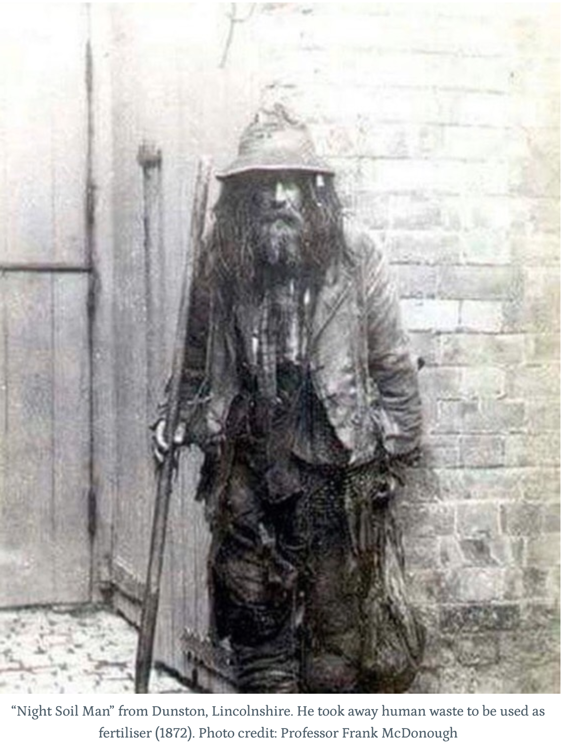
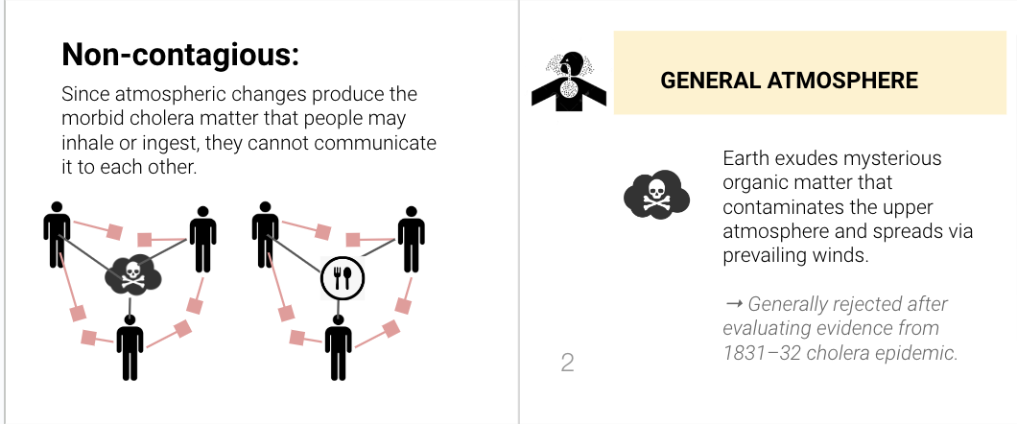
Explanations for cholera (19th Century London)
A Night-Soil Man
Generally Airborne-Noncontagious: People get cholera by inhaling generally polluted air (source is somewhere from earth's surface: hard to avoid unless you leave the area). (...)

Slide 6
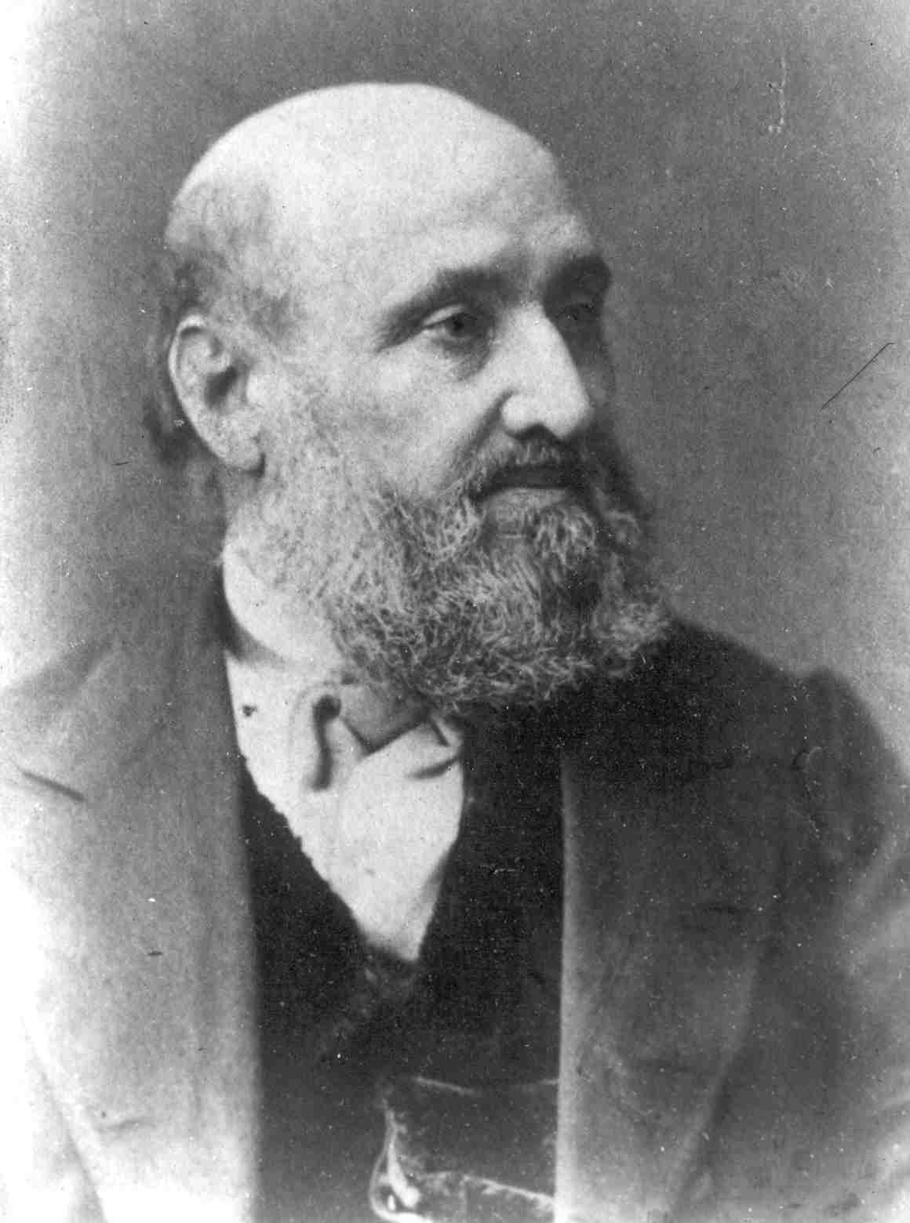
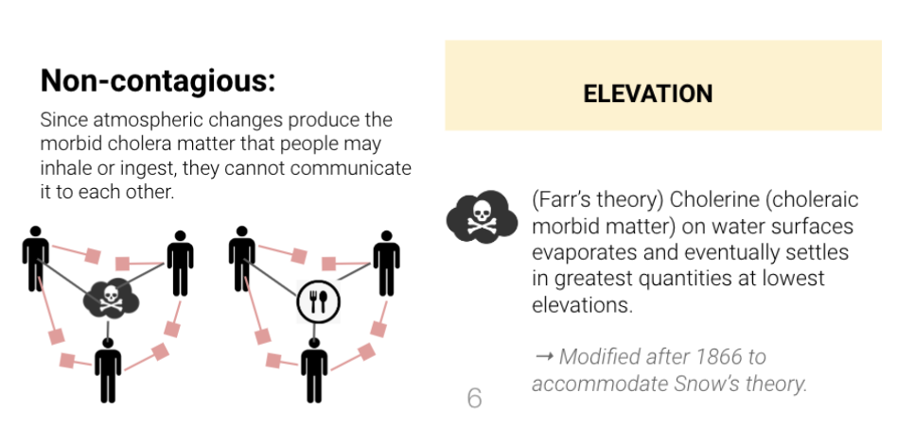
Explanations for cholera (19th Century London)
William Farr, Registrar General of London
Airborne-Elevation: People get cholera after inhaling polluted air that settles in low elevation areas (move out of low-elevation areas). (...)

Slide 7
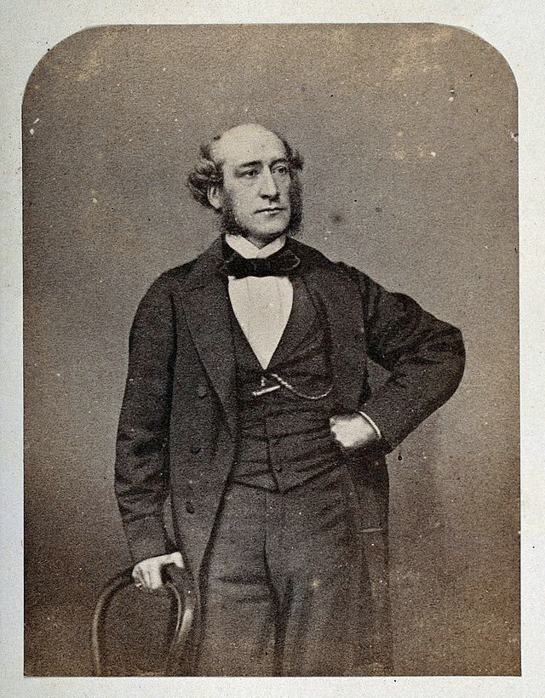

Explanations for cholera (19th Century London)
Dr. William Rogers
Locally Airborne - Non-contagious: People get sick by inhaling locally polluted air (e.g. coming from sewage through gullies: avoid inhaling air from sewers ). (...)

Slide 8

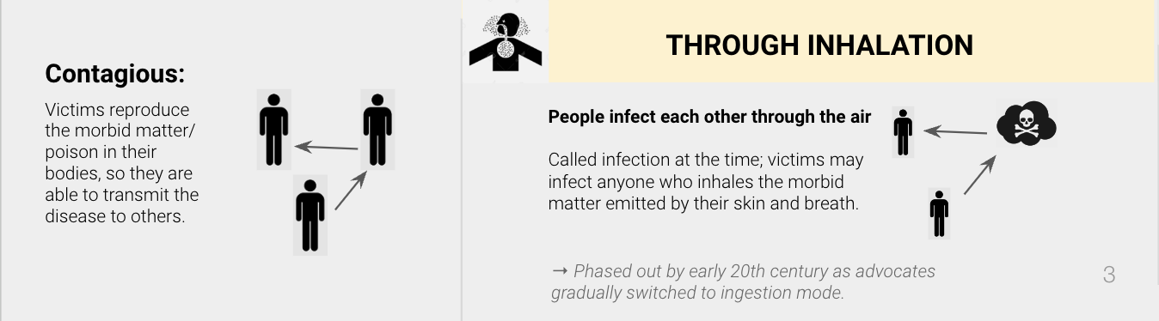
Explanations for cholera (19th Century London)
Blanche Smith, Wife of a Brass Finisher
Airborne-Contagious: People infect each other through the air (students will find this familiar because of covid: greater distancing would reduce risk). (...)

Slide 9
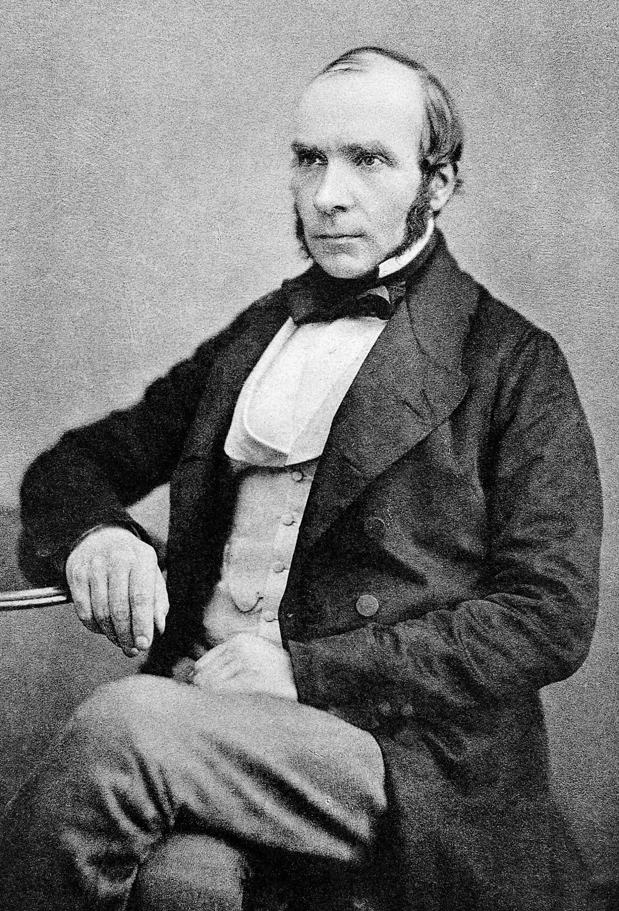
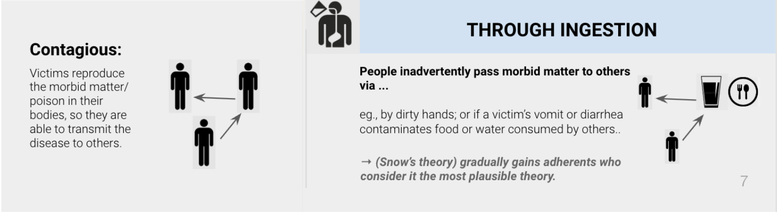
John Snow
Doctor
Noticed that cholera affected the gastrointestinal system (guts)
Hypothesized that contaminated drinking water was the cause of cholera
Not in the majority at the time (...)

Slide 10


The Tale of Two Theories…
Airborne
Inhalation of a poison given off by dead or contaminated organic matter (like sewage) which enters the body through the lungs and poisons the blood.
Waterborne
Ingestion of “excretions of the sick” which contain a living organism which infects the gastrointestinal system (guts).

Slide 11

